Slide 1
Building Violations
Mid-Semester Report
Team C
Youxuan Ma, Guanxi Li, Heyang Yu, Yuzhe Jiang, Jian Xie

Slide 2
Key Questions Answered
Q1: Are there certain landlords / management companies that have repeated violations?
Q2: Are there common features of certain buildings?
Q3: What neighborhoods / communities are affected most?
Q4: What kinds of building complaints are people making around the city?

Slide 3
Q4:
What kinds of building complaints are people making around the city?

Slide 4
Q4: What kinds of building complaints are people making around the city?
We wanted to figure out which issues people report the most, so we refined our categorization of issue types further.
First, we combined columns like `case_title`, `subject`, `reason`, and `type` into one because they give us all the info we need about the issue.
Next, we put this combined column into a pre-trained model called DistilBERT to code it, and used K-Means with a silhouette score to cluster them.
Through these, we ended up with 40 different types of issues.

Slide 5
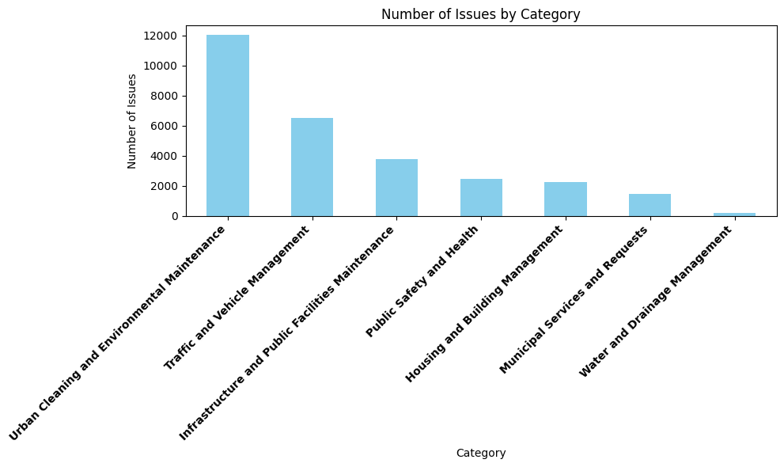
Q4 Continued
To really understand what each of these 40 types means, we looked for data points that best represent the center of each cluster. We did this by finding the point closest to its cluster's center. This way, we got a clear description for each type of issue.
However, 40 types of issues were still too many for further analysis, so we used a Large Language Model to categorize these 40 types into 7 groups.
As we can see, the issues mainly centered around:
Urban Cleaning and Environmental Maintenance
Traffic and Vehicle Management
Infrastructure and Public Facilities Maintenance

Slide 6
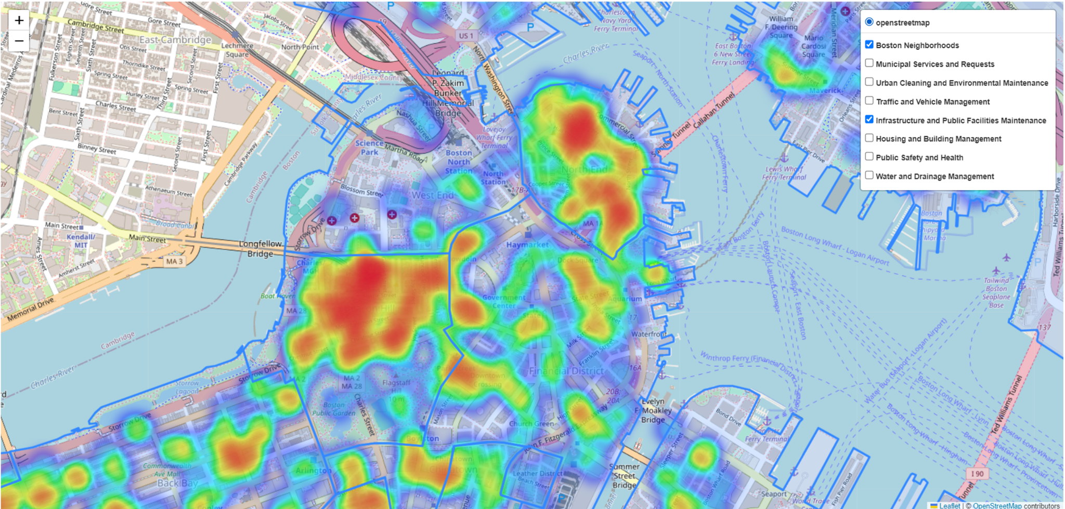
Q4 Continued
We then visualized these 7 categories with a heatmap and analyzed their numbers. The map shows which type of issue is reported most frequently in which neighborhood.

Slide 7
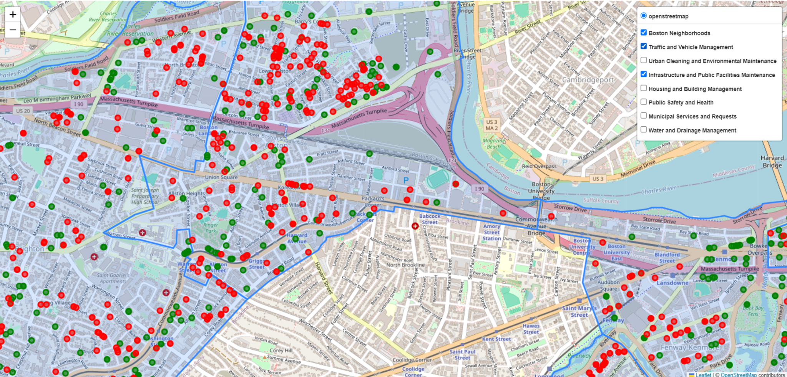
Q4 Continued
To further explore, we mapped each building to its coordinates. This graph displays the distribution of two types of issues: `Traffic and Vehicle Management` and `Infrastructure and Public Facilities Maintenance`. Each issue is represented by a different color.

Slide 8
Q2:
Are there common features of certain buildings?

Slide 9
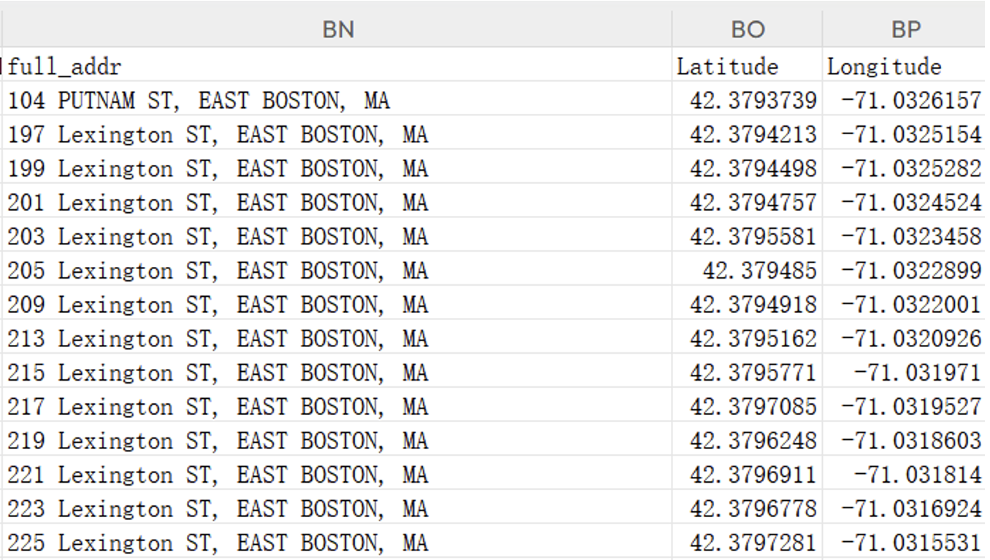
Q2: Are there common features of certain buildings?
First off, we noticed that the dataset didn't have latitude and longitude coordinates, only detailed street addresses. So, we used geocoding tech to get the latitude and longitude for all the addresses. This will help us visualize some features on a map later on.
We combined ST_NUM, ST_NAME, CITY, and MA into one column, which we called "full_addr", to represent the complete address.

Slide 10
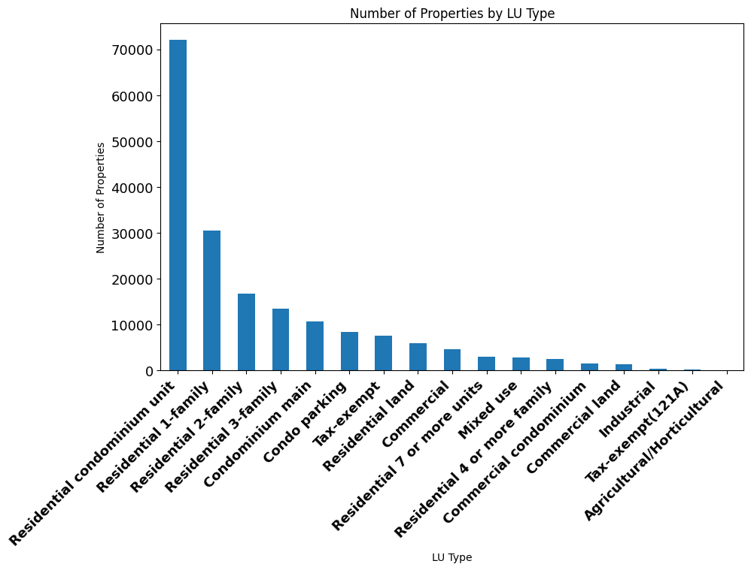
Q2 Continued
To better analyze this issue, we approach it from the perspective of someone who needs to select a house.
The first aspect we focus on is the type of housing. Therefore, we conducted visual analysis for each category of housing type, obtaining the actual distribution and quantity for each type.
This enables us to clearly understand where suitable housing types are located if I need to work or study in a certain area.

Slide 11
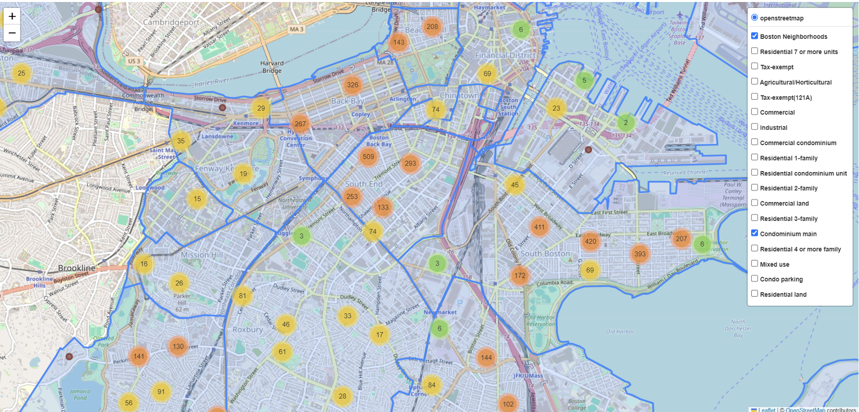
Q2 Continued
Clustering houses of the same type reveals the distribution of different categories of housing. Deeper colors indicate higher density.
This can also be seen as a heatmap.

Slide 12
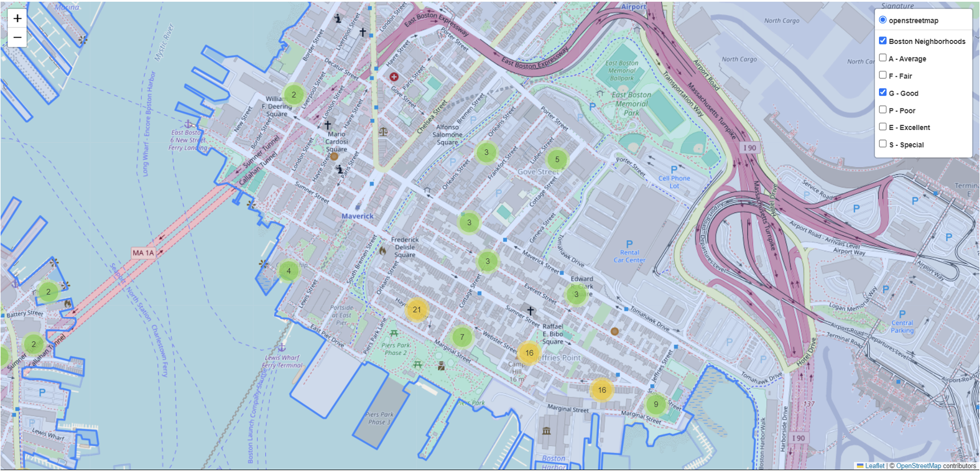
Q2 Continued
Next, we analyzed the view of the houses, since people nowadays are increasingly concerned with outdoor views for their houses, and beautiful landscapes often bring better moods.
We analyzed the PROP_VIEW column and visually analyzed properties with different ratings, including their distribution on the map and quantity comparisons. Among them, the majority have an average rating, while only a few of them have a poor rating.

Slide 13
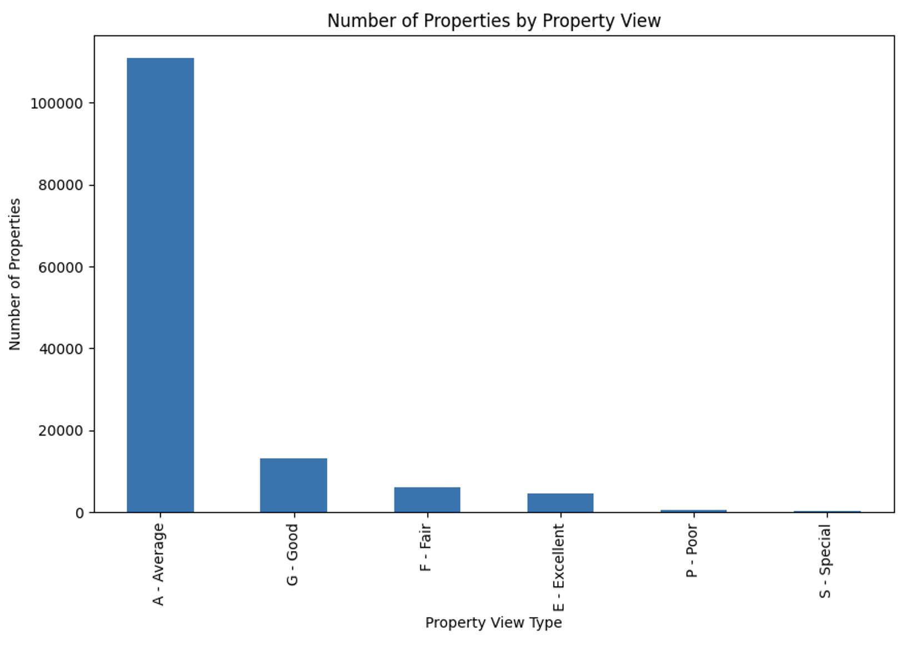
Q2 Continued
We also performed similar clustering on PROP_VIEW to display the distribution of different ratings.

Slide 14
Q2 Continued
Next, we analyzed the indoor and outdoor conditions. There are three columns in the dataset related to indoor and outdoor analysis: INT_COND, EXT_COND, and OVERALL_COND.
Considering that different people have different priorities, we designed three weighting methods to rate the indoor and outdoor conditions of the property. The three ratings take into account those who are more concerned about indoor environments, those who focus more on outdoor environments, and those who prioritize overall conditions.
We used these three methods to rate each property three times, obtaining three scores. We then used the Folium library to output these scores as a feature heatmap, allowing us to see where high-scoring houses are located.
Additionally, we separately counted the quantity of different ratings for these three columns.

Slide 15
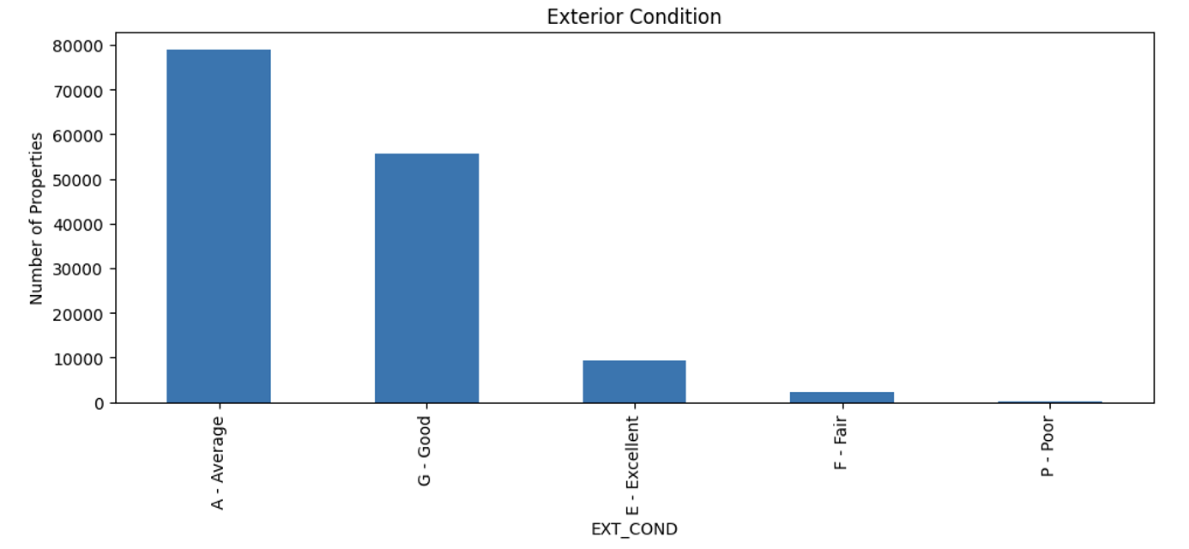
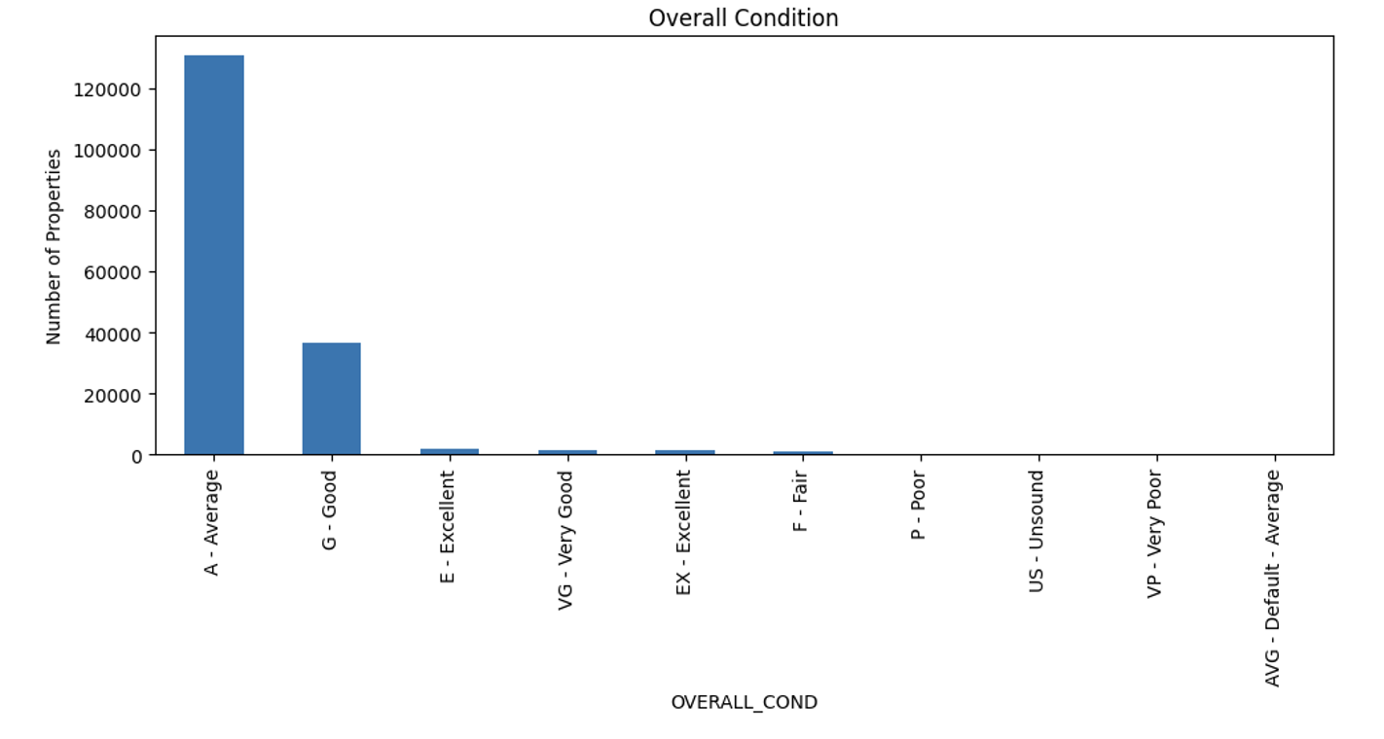
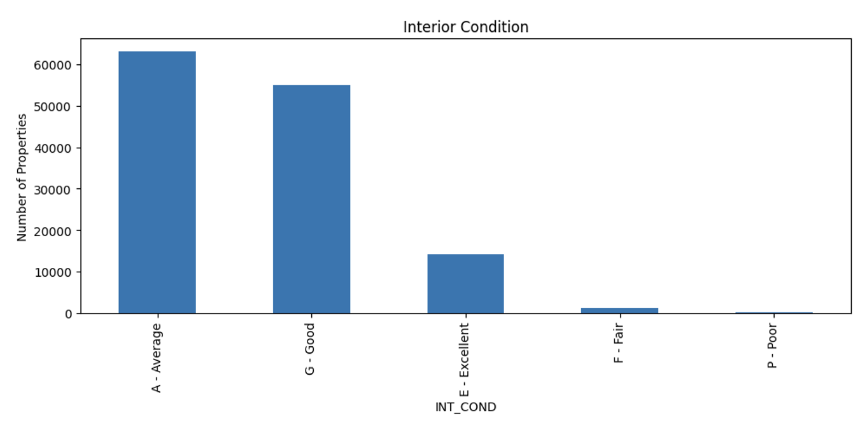
Q2 Continued
The quantity of each of the three types.

Slide 16
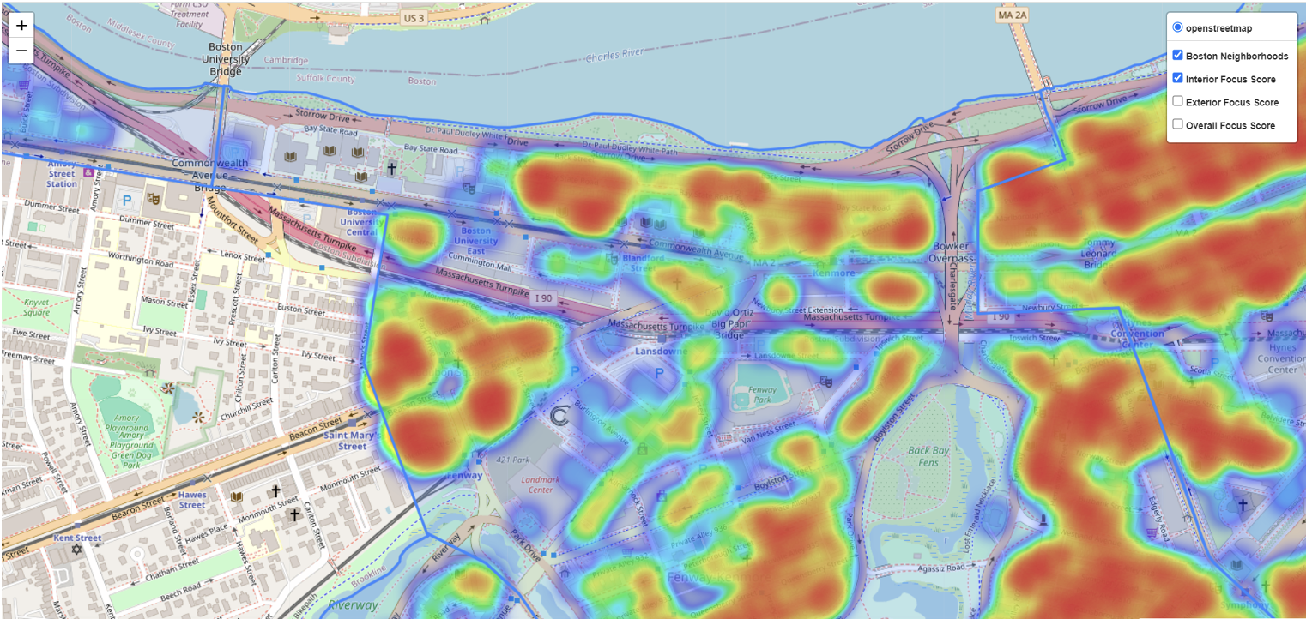
Q2 Continued
The heatmap shown below is generated based on the scoring of the interior conditions, where darker colors represent higher scores

Slide 17
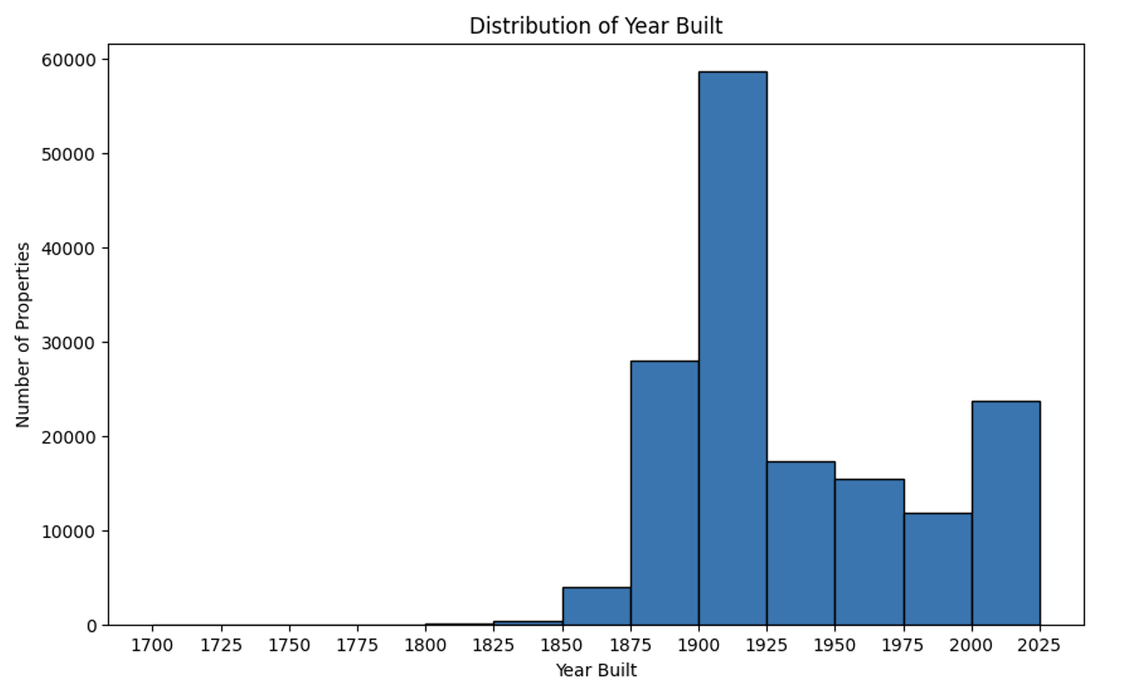
Q2 Continued
Finally, considering that many people are concerned about the age of the house, we explored the construction year.
We divided the years into intervals of 25 years each and counted the number of buildings in each interval. We also marked the distribution of buildings for each interval on the map.

Slide 18
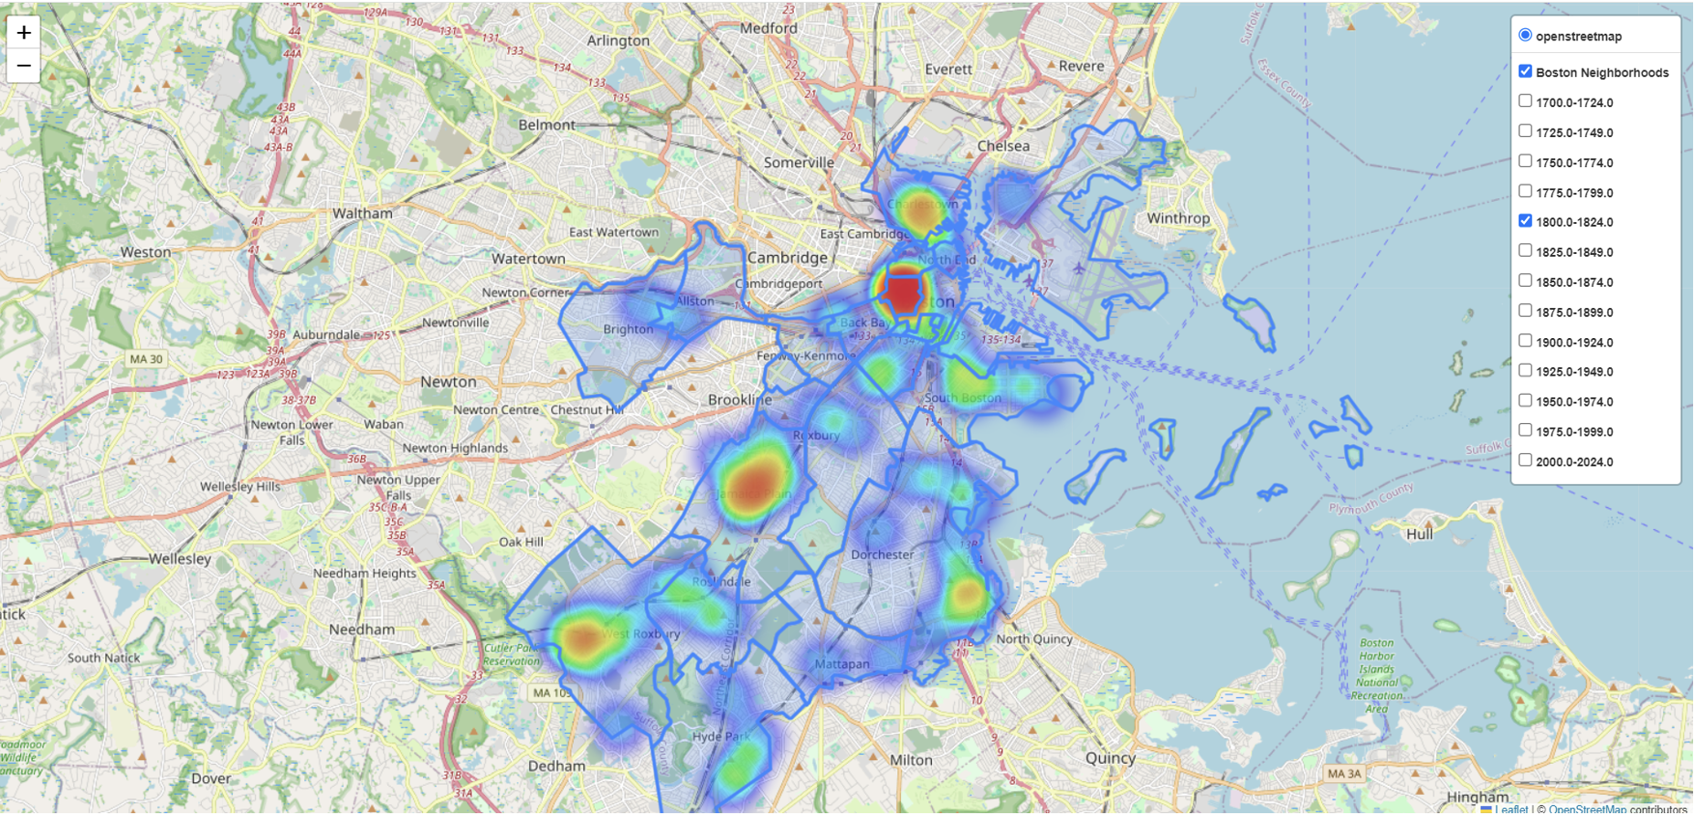
Q2 Continued
The heatmap below shows the distribution of houses built between 1800 and 1824.

Slide 19
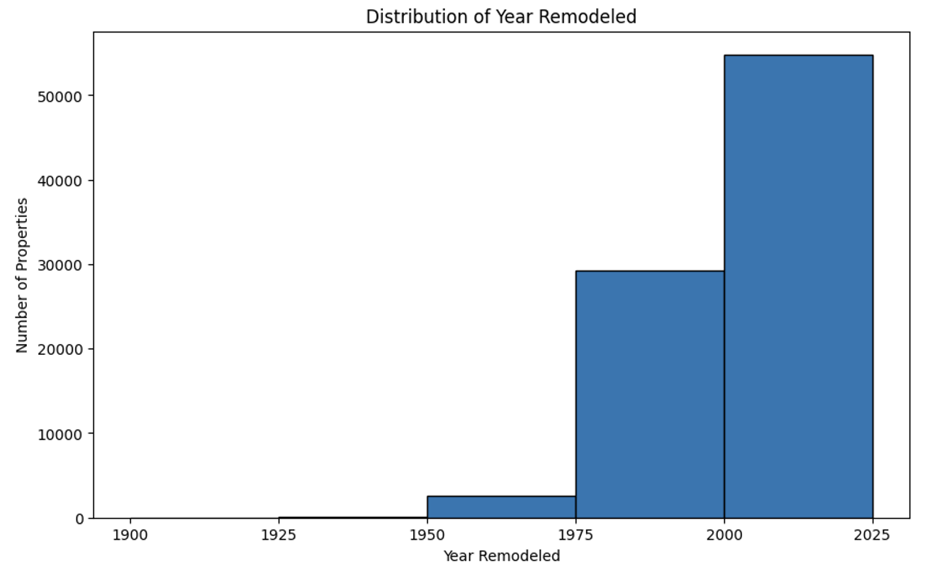
Q2 Continued
Similarly, we analyzed the situation of remodeling and conducted the same visual analysis.

Slide 20
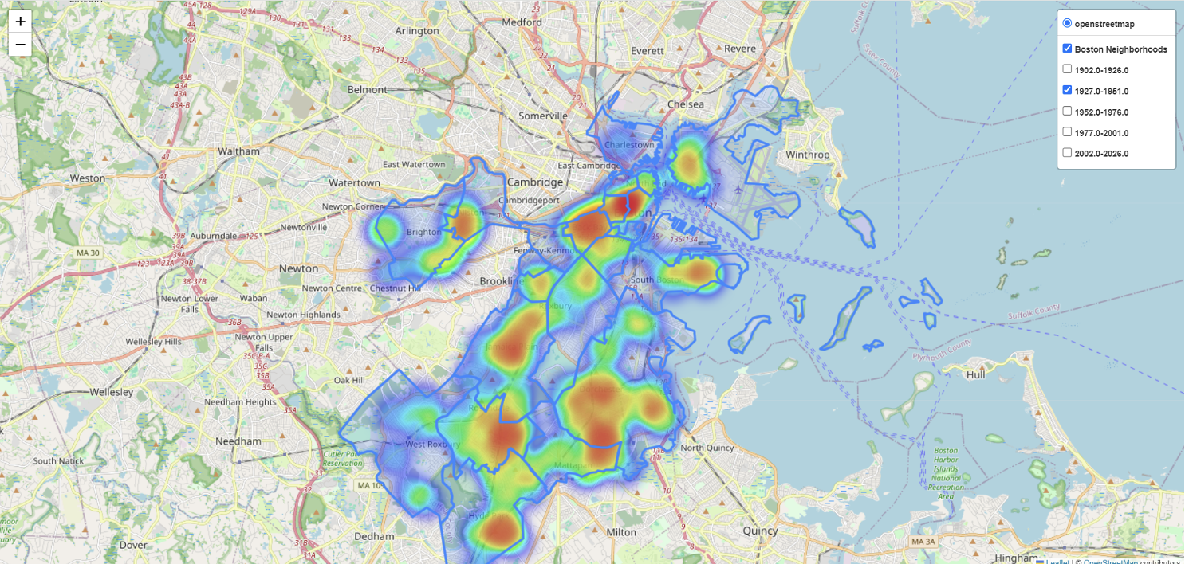
Q2 Continued
The heatmap below depicts houses remodeled between 1927 and 1951.

Slide 21
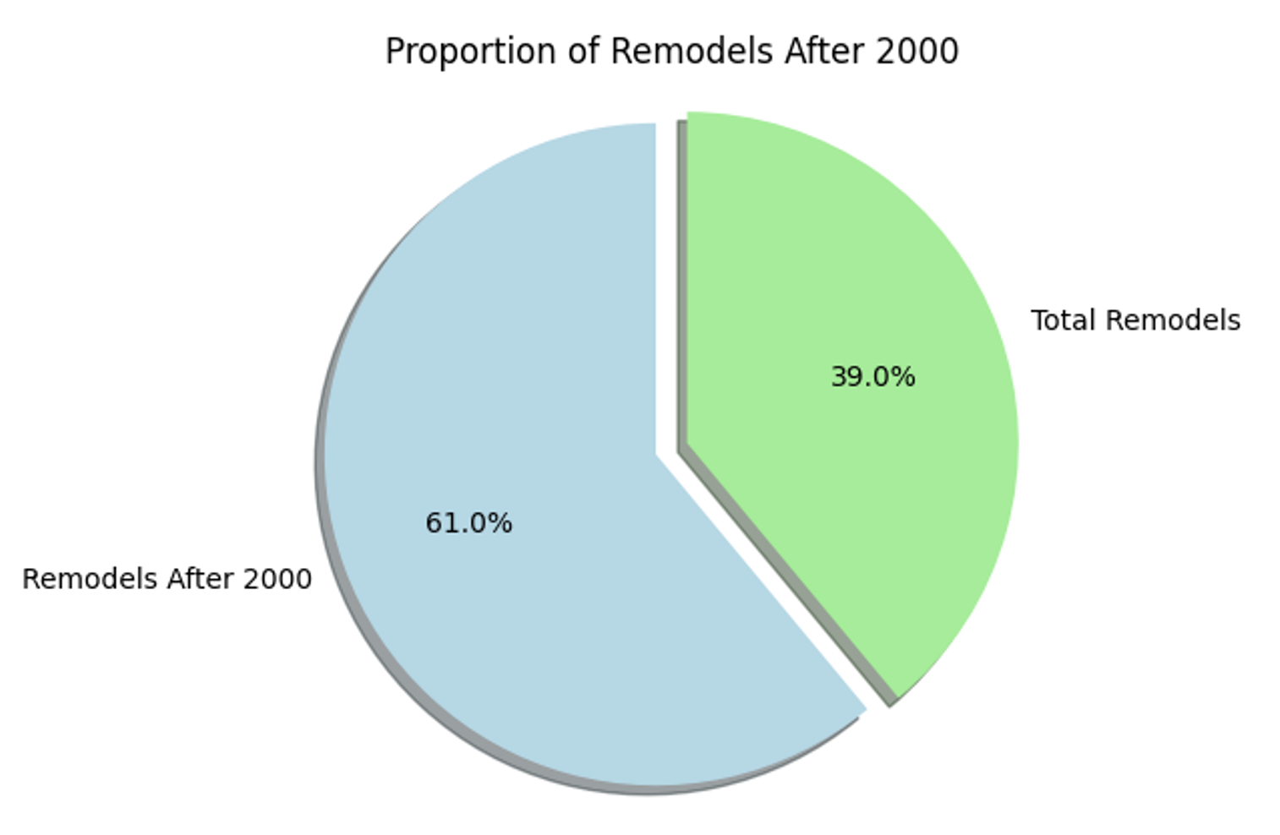
Q2 Continued
Considering that people prefer houses remodeled in recent years, we calculated the proportion of houses remodeled after the year 2000 to all remodeled houses and found it to be over 60%.
This indicates that the majority of houses have sufficient safety standards.

Slide 22
Live Demo

Slide 23
Q&A Session

Slide 24
Thank you for watching!

